Slide 1

Towards Fairness in Transportation Gig Markets:
Identifying, Imitating, and Mitigating
Algorithm Discrimination via Deep Reinforcement Learning
Zijian Zhao, Sen Li
Department of Civil and Environmental Engineering
The Hong Kong University of Science and Technology
Presentation at 31st AAAI/SIGAI Doctoral Consortium, January 20, 2026
[1] Zhao, Zijian, and Sen Li. "The impacts of data privacy regulations on food-delivery platforms." Transportation Research Part C: Emerging Technologies 181 (2025): 105364.
[2] Zhao, Zijian, and Sen Li. "TDiscriminatory Order Assignment and Payment-Setting of On-Demand Food-Delivery Platforms: A Multi-Action and Multi-Agent Reinforcement Learning Framework." Transportation Research Part E: Logistics and Transportation Review 182 (2026): 105364

Slide 2
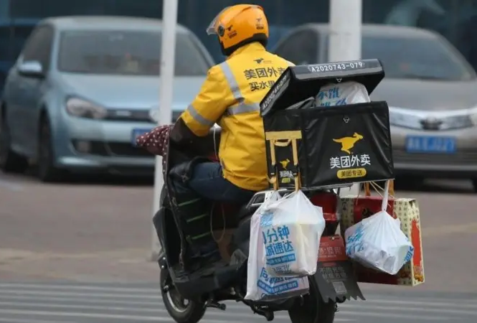
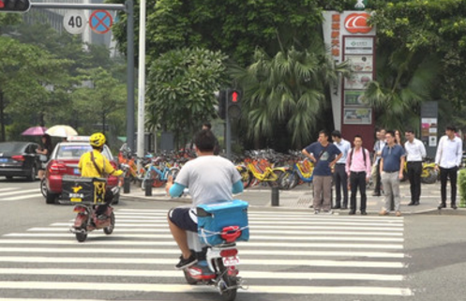

Background: Algorithm Discrimination in Food-Delivery Platforms
Learning algorithm in food-delivery platforms:
profit maximization: Platforms aim to achieve optimal control over couriers while offering the lowest payment.
overuse of privacy data: Platforms utilize personal data to differentiate between various types of couriers.
Discriminatory algorithmic labor management:
personalized payment: Couriers have varying expected salaries for the same work (referred to as ‘reservation value’) → violating principle of ‘equal pay for equal work’
dispatching preference: Couriers with high willingness to work present higher certainty and lower costs for platforms → prioritize couriers with more favorite working pattern
Couriers controlled by algorithms:

Slide 3



Background: Data Privacy Regulation (DPR)
Take GDPR (Europe) as an example:
Article 6.1.a : Data processing is lawful only when the data subject has provided consent for one or more specific purposes.
Article 7.2: Individuals have the right to withdraw consent at any time, and the process for withdrawal must be as simple as providing consent.
Basic principles of DPR:
data minimization
user content, individual control over personal information
GDPR
PIPL
CCPA

Slide 4
Research Questions
Research questions:
Q1: How to model and optimize the behavior and strategy of platforms and couriers?
Q2: How does the discriminatory algorithm influence platforms and couriers?
Q3: How does data privacy regulation policy influence food delivery market?

Slide 5
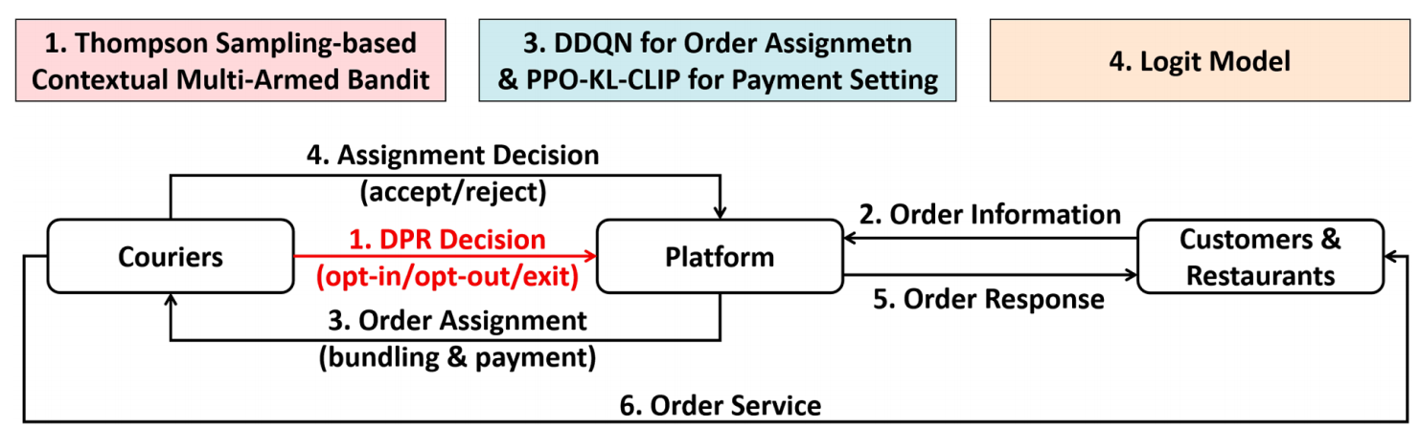
System Workflow
Platform：determine order assignment and payment setting
Couriers：
long-term: choose from opt-in (work with providing personal information), opt-out (work without providing personal information), or exit (do not work) at the beginning of each time period
short-term: determine whether to accept the assigned order based on payment and individual reservation value
Customers & Restaurants:
set orders at arbitrary times
cancel the order if not confirmed within a maximium time threshold

Slide 6
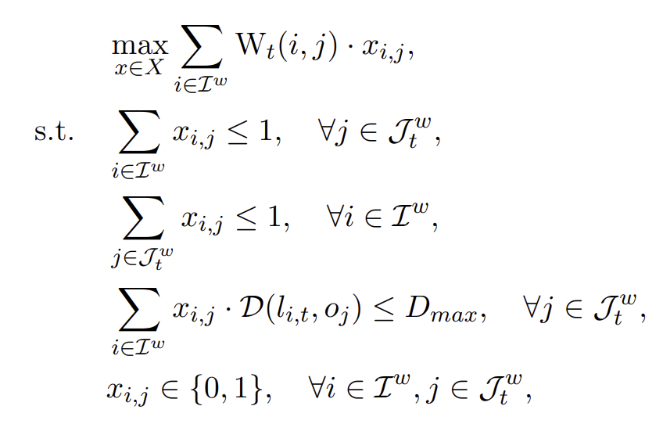

Solution Methodology for MDP of Platform
DDQN for Order Assignment:
Summary: A neural network is employed to estimate the long-term reward (Q-value) for each courier selecting each order at each time step.
Utilization: Find the optimal dispatching strategy to maximize the global Q-value (long-term reward) at each step through bipartite matching.
Training: gradient descent to minimize Temporal Difference (TD) error
$W_{t}(i,j)$: Q-value representing the value of assigning order j to courier i at time t
$x_{i,j}$: binary indicator for whether order j is assigned to courier i
$D(l_{i,t},o_{j})$: distance between courier i and the origion of order j
$D_{max}$: maximium matching distance
$J_{t}^{w}$: indices of orders to be assigned at time t

Slide 7
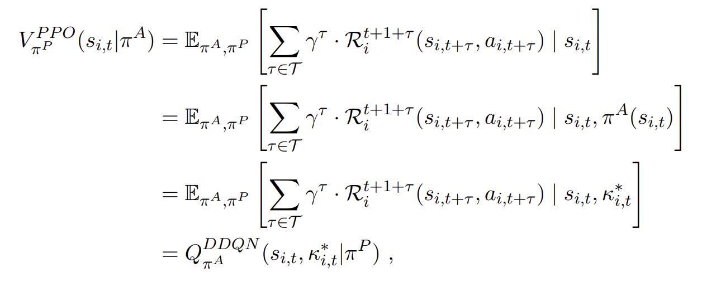
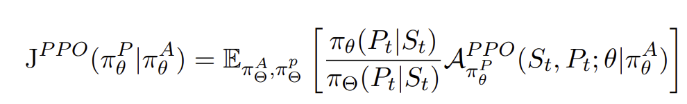
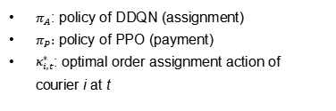
Solution Methodology for MDP of Platform
PPO for Payment Setting:
Summary: An actor network is employed to directly generate payments for each courier, while a critic network estimates the V-value to guide the updating of the critic network.
Finding: In our scenario, the PPO can directly utilize the Q-network of DDQN as the critic network.
Training of actor: policy gradient to maximize the objective function
$π_{A}$: policy of DDQN (assignment)
$π_{P}:$ policy of PPO (payment)
$κ_{i,t}^{∗}$: optimal order assignment action of courier i at t

Slide 8
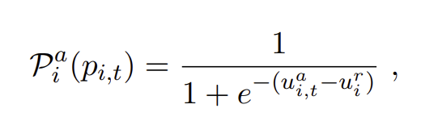
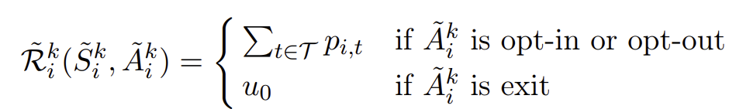
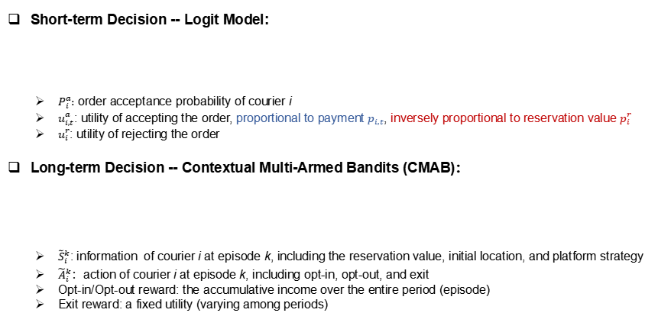
Model for Couriers: Logit Model & CMAB
Short-term Decision -- Logit Model:
$P_{i}^{a}:$ order acceptance probability of courier i
$u_{i,t}^{a}$: utility of accepting the order, proportional to payment $p_{i,t}$, inversely proportional to reservation value $p_{i}^{r}$
$u_{i}^{r}$: utility of rejecting the order
Long-term Decision -- Contextual Multi-Armed Bandits (CMAB)：
${\tilde{S}}_{i}^{k}$: information of courier i at episode k, including the reservation value, initial location, and platform strategy
${\tilde{A}}_{i}^{k}$：action of courier i at episode k, including opt-in, opt-out, and exit
Opt-in/Opt-out reward: the accumulative income over the entire period (episode)
Exit reward: a fixed utility (varying among periods)

Slide 9
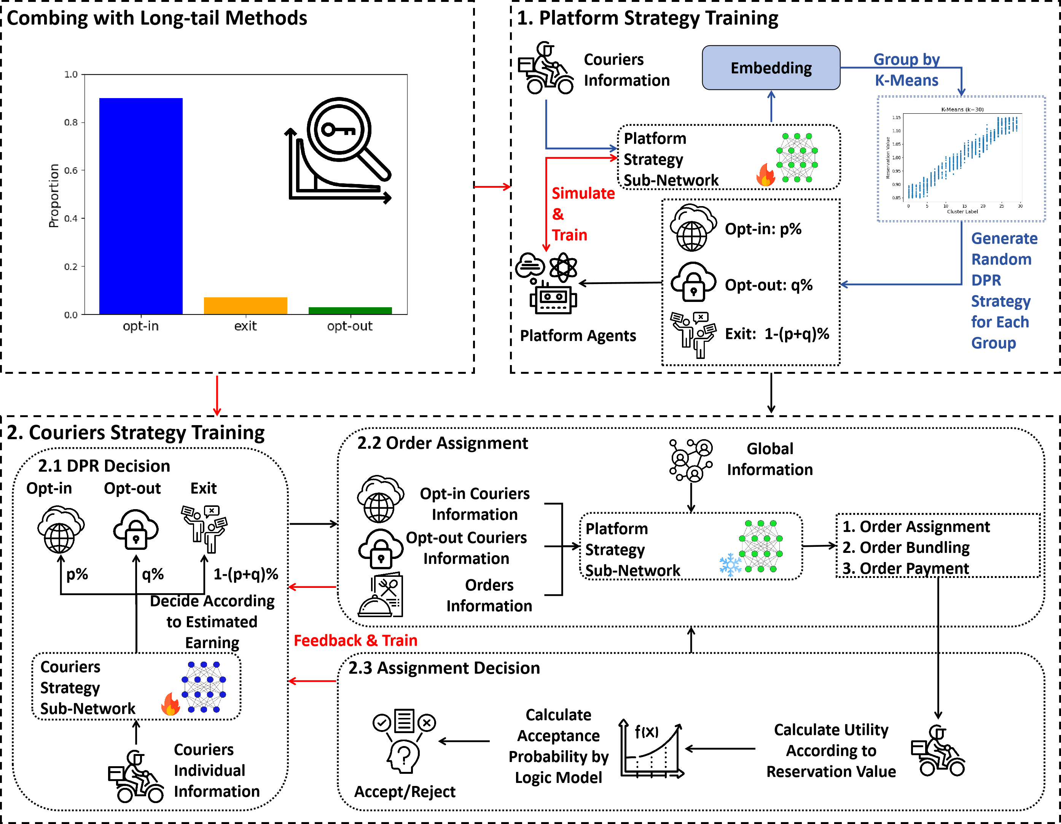
Training Process
Phase1: Platform Training
train an adaptive policy that optimally responds to all possible decisions made by couriers
Phase2: Couriers Training
given the fixed well-trained platform strategy, train couriers to identify the optimal long-term decisions aimed at maximizing cumulative earnings

Slide 10
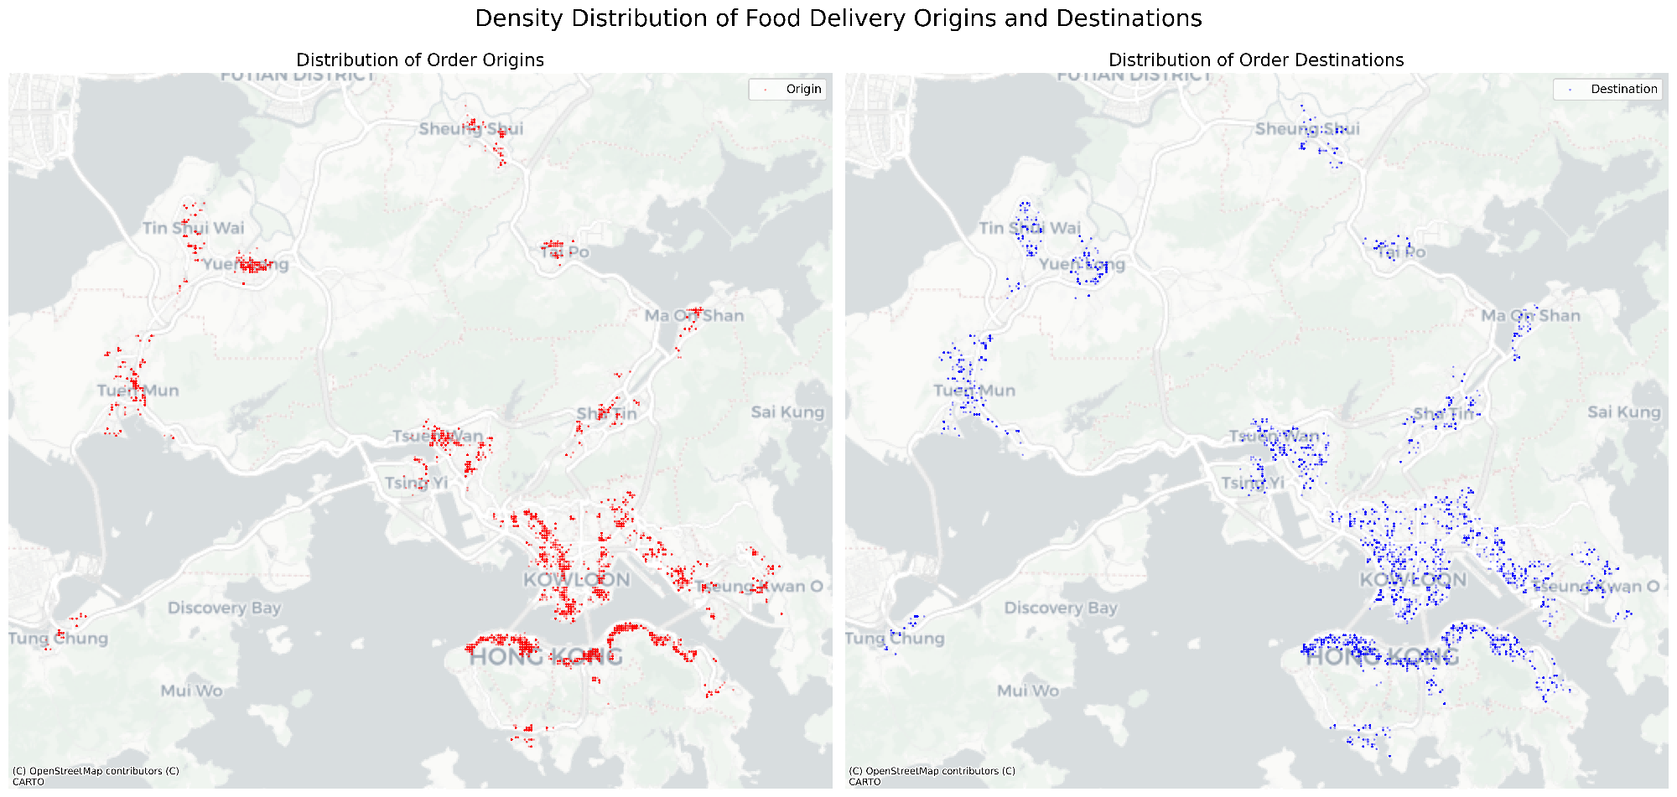
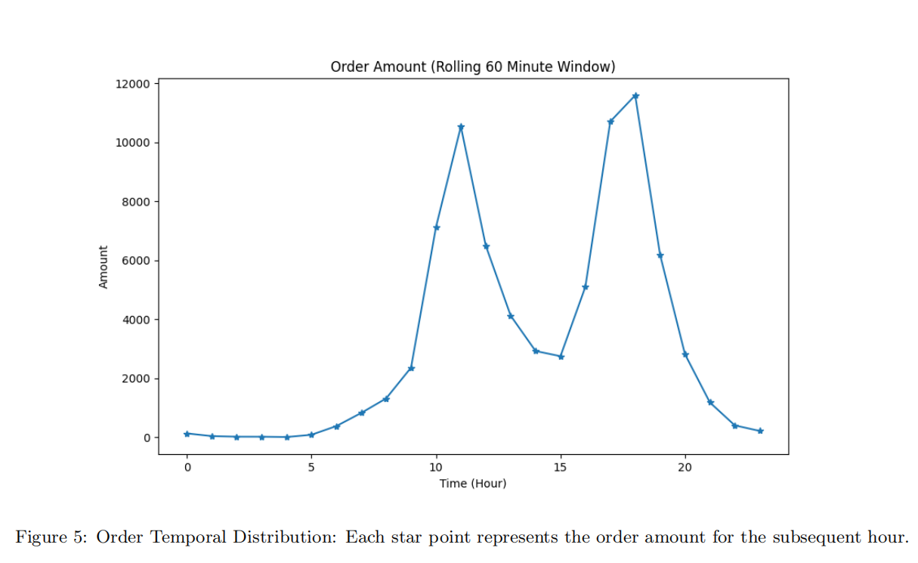
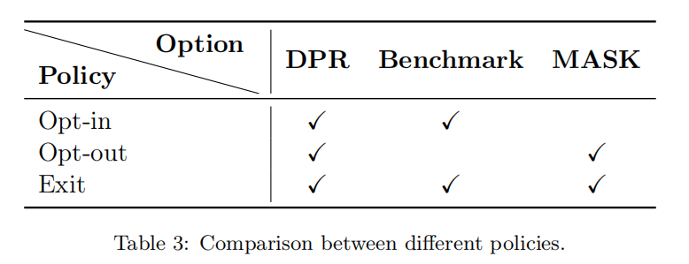
Case Studies
Food Delivery in Hong Kong, China
Comparative Policies

Slide 11
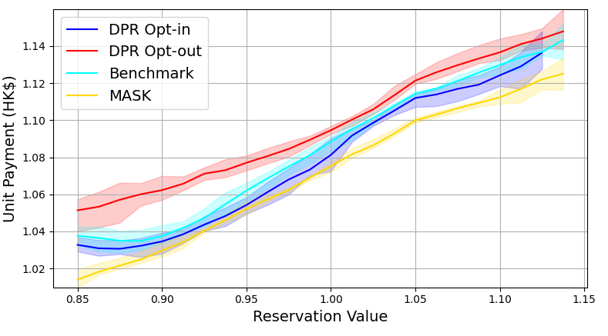
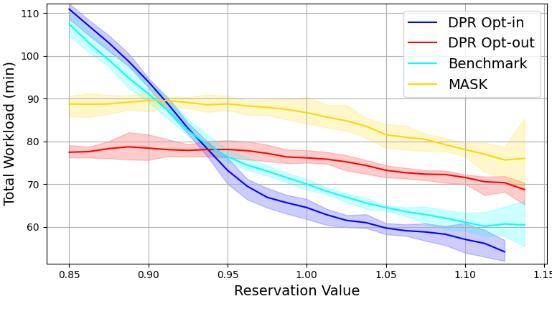
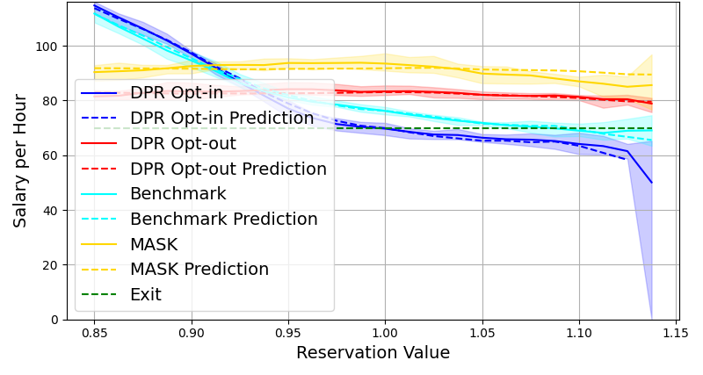
Case Studies
Unit Payment (payment per minute)
Total Workload (measured by time)
Total Earning (whole preiod)
How platforms discriminate different types of couriers？
For opt-in couriers (blue curves): Higher reservation couriers receive:
higher unit payments
lower workloads
lower total earnings
For opt-out couriers (red curves): Higher reservation couriers experience:
higher unit payments
slightly lower workloads
similar earnings compaerd to low reservation couriers

Slide 12
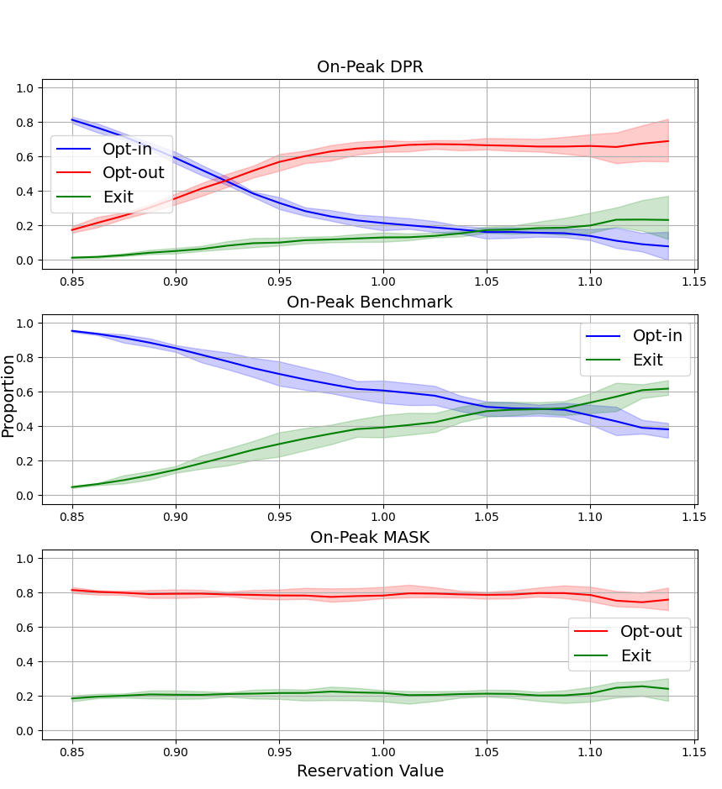
Case Studies
How DPR affects couriers behavior？
More couriers are attracted to choose opt-out option on the platform, leading to a lower exiting rate.
DPR effectively protects the rights of high-reservation couriers, allowing them to choose opt out to access more work opportunities.
Proportion of Choices Among Couriers

Slide 13
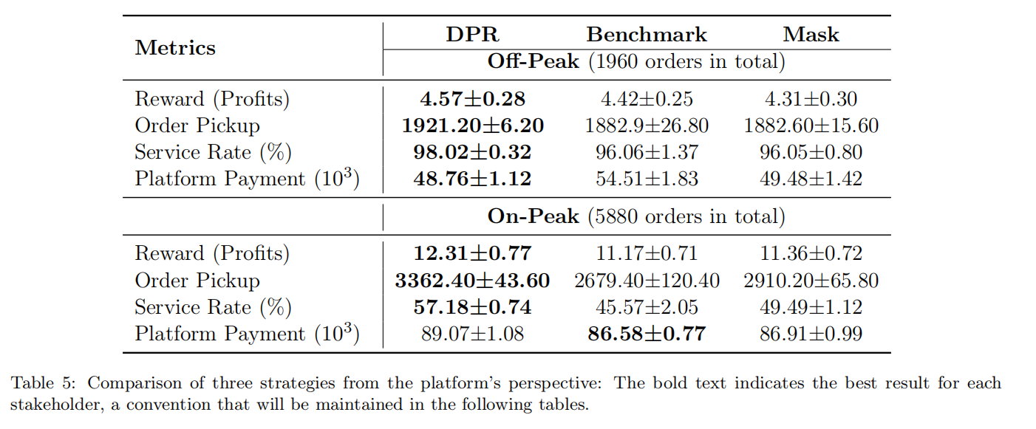
Case Studies
How DPR affects platform profits？
The platform gets higher profits since the increased number of active couriers helps fulfill more orders.

Slide 14
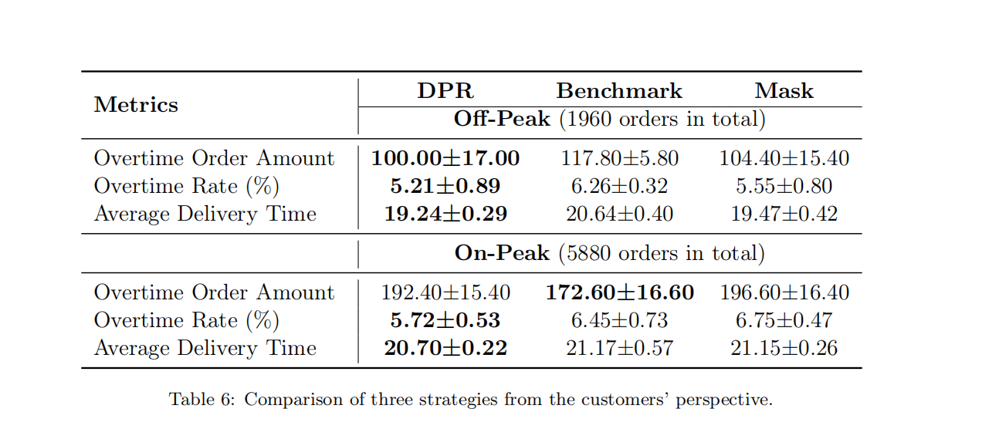
Case Studies
How DPR affects customers satisfication？
Customers get better experience due to the increased number of active couriers, which allows the platform to optimize planning better, leading to a lower order delivery times.

Slide 15
Thanks for your attention!
Presented by Zijian Zhao

Slide 16
Research Questions
Challenges in identifying the DPR for stakeholders:
The dispatching strategy and payment strategy of platforms are coupled.
Couriers' behaviors occur on different time scales:
long-term: decide whether to work on the platform and whether to share their personal information
short-term: determine whether to accept assigned orders
Complex game process between platform and couriers, as well as among the couriers themselves
Research questions:
Q1: How to model and optimize the behavior and strategy of platforms and couriers?
Q2: How does the discriminatory algorithm influence platforms and couriers?
Q3: How does data privacy regulation policy influence food delivery market?

Slide 17
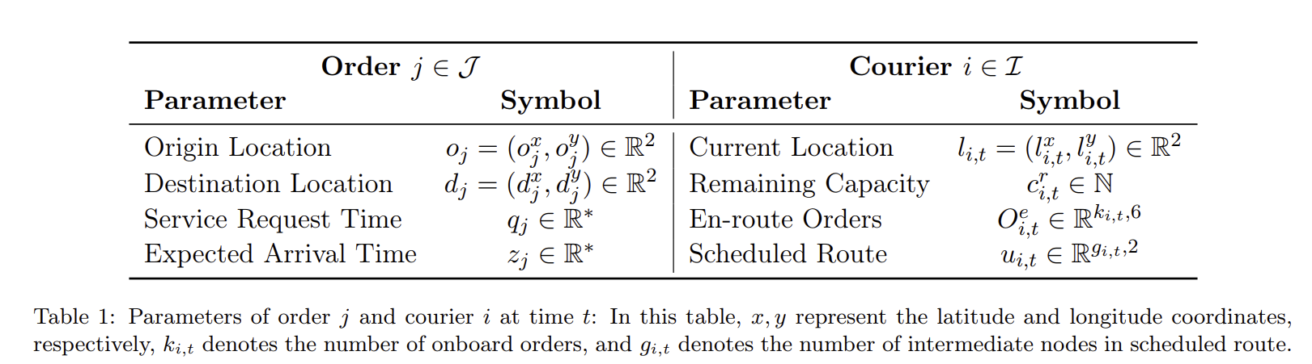
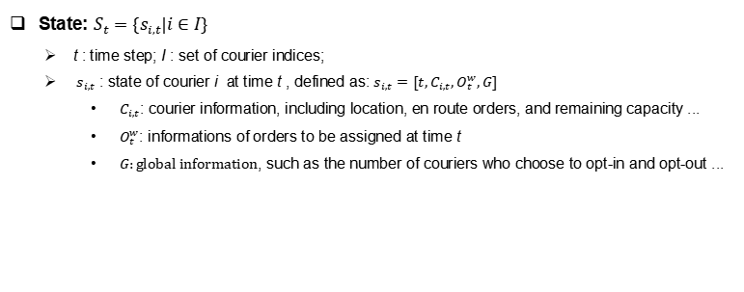
Model for Platform: MDP
State: $S_{t}=\{s_{i,t}|i∈I\}$
t : time step; I : set of courier indices;
$s_{i,t}$ : state of courier i at time t , defined as: $s_{i,t}=[t,C_{i,t},O_{t}^{w},G]$
$C_{i,t}$: courier information, including location, en route orders, and remaining capacity ...
$O_{t}^{w}$: informations of orders to be assigned at time t
$G:global information$, such as the number of couriers who choose to opt-in and opt-out ...

Slide 18
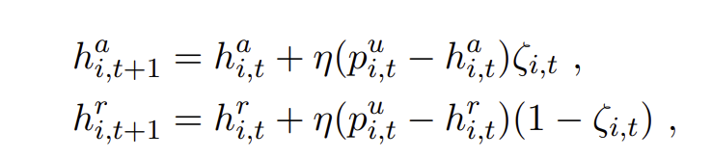
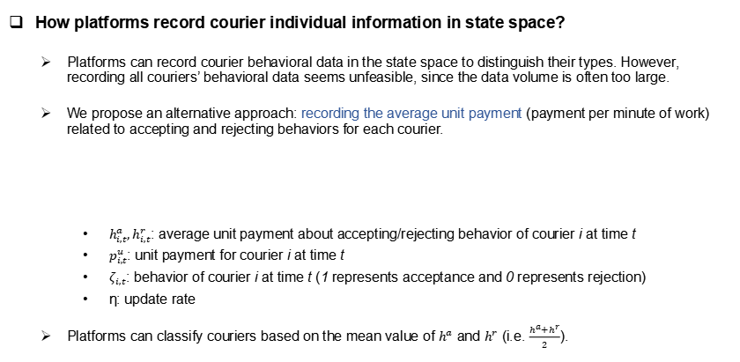
Model for Platform: MDP
How platforms record courier individual information in state space?
Platforms can record courier behavioral data in the state space to distinguish their types. However, recording all couriers’ behavioral data seems unfeasible, since the data volume is often too large.
We propose an alternative approach: recording the average unit payment (payment per minute of work) related to accepting and rejecting behaviors for each courier.
$h_{i,t}^{a},h_{i,t}^{r}$: average unit payment about accepting/rejecting behavior of courier i at time t
$p_{i,t}^{u}$: unit payment for courier i at time t
$ζ_{i,t}$: behavior of courier i at time t (1 represents acceptance and 0 represents rejection)
η: update rate
Platforms can classify couriers based on the mean value of $h^{a}$ and $h^{r}$ (i.e. $\frac{h^{a}+h^{r}}{2}$).

Slide 19
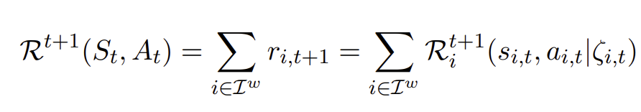
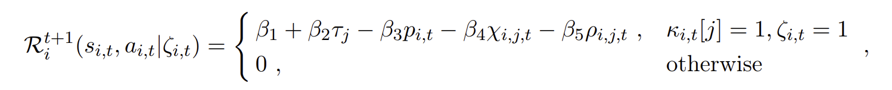

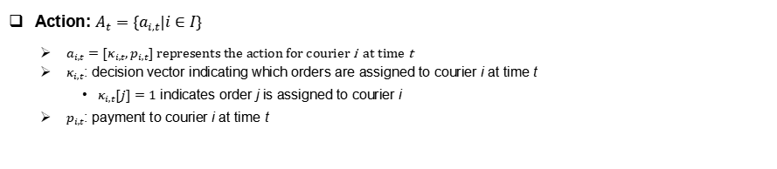
Model for Platform: MDP
Action: $A_{t}=\{a_{i,t}|i∈I\}$
$a_{i,t}=[κ_{i,t},p_{i,t}]$ represents the action for courier i at time t
$κ_{i,t}$: decision vector indicating which orders are assigned to courier i at time t
$κ_{i,t}[j]=1$ indicates order j is assigned to courier i
$p_{i,t}$: payment to courier i at time t
Reward Function:
$R_{ }^{t+1}$: global reward at time t; $R_{i}^{t+1}$: reward for courier i at time t; $I_{ }^{w}$: set of working courier indices
β: positive weights
$τ_{j}$: trip distance of oredr j; $χ_{i,j,t}$: the number of en-route orders for courier i at time t that will exceed their expected time;$ρ_{i,j,t}$: additional travel time of all en-route orders for courier i at time t
Notes:
platform income from customer
platfomr outcome (payment to couriers)
customer satisfaction

Slide 20
Model for Couriers: Logit Model & CMAB
Short-term Decision -- Logit Model:
$P_{i}^{a}:$ order acceptance probability of courier i
$u_{i,t}^{a}$: utility of accepting the order, proportional to payment $p_{i,t}$, inversely proportional to reservation value $p_{i}^{r}$
$u_{i}^{r}$: utility of rejecting the order
Long-term Decision -- Contextual Multi-Armed Bandits (CMAB)：
${\tilde{S}}_{i}^{k}$: information of courier i at episode k, including the reservation value, initial location, and platform strategy
${\tilde{A}}_{i}^{k}$：action of courier i at episode k, including opt-in, opt-out, and exit
Opt-in/Opt-out reward: the accumulative income over the entire period (episode)
Exit reward: a fixed utility (varying among periods)

Slide 21
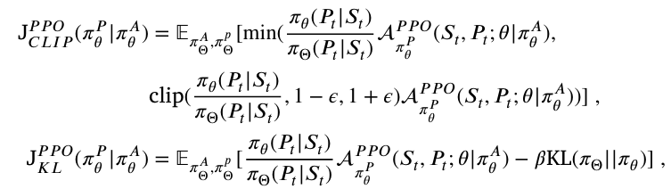
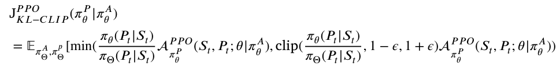
PPO-KL-CLIP for Platform Payment Setting
Original PPO —— Unstable Chanllenge^{[4,5]}:
PPO-CLIP: If new policy θ have already deviated original policy Θ significantly, the gradient becomes 0, preventing the policy from recovering.
PPO-KL: The performance can be influenced by β significantly, necessitating a balance between KL-restriction and policy updates.
Our Solution: PPO-KL-CLIP
inspired by GRPO^{[6]}
add KL normalization to PPO-CLIP, helping recover the deviated policy.

Slide 22
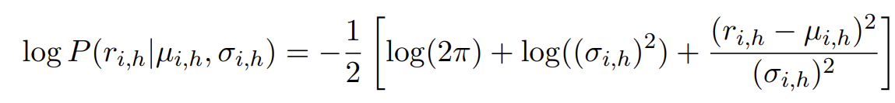
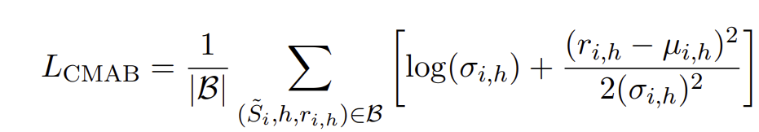

Solution Methodology for CMAB of Couriers
Thompson Sampling Method:
Summary: Utilize a neural network to estimate the reward distribution for each action within a given state.
Utilization: Select the action with the highest reward expectation.
Training: Model the reward distribution as a Gaussian distribution and train the network using Maximum Likelihood Estimation (MLE).
$h$: action index, corresponding to opt-in, opt-out, and exit
$u,σ$: mean and standard deviation of the estimated reward distribution, respectively
$B$: experience buffer

Slide 23
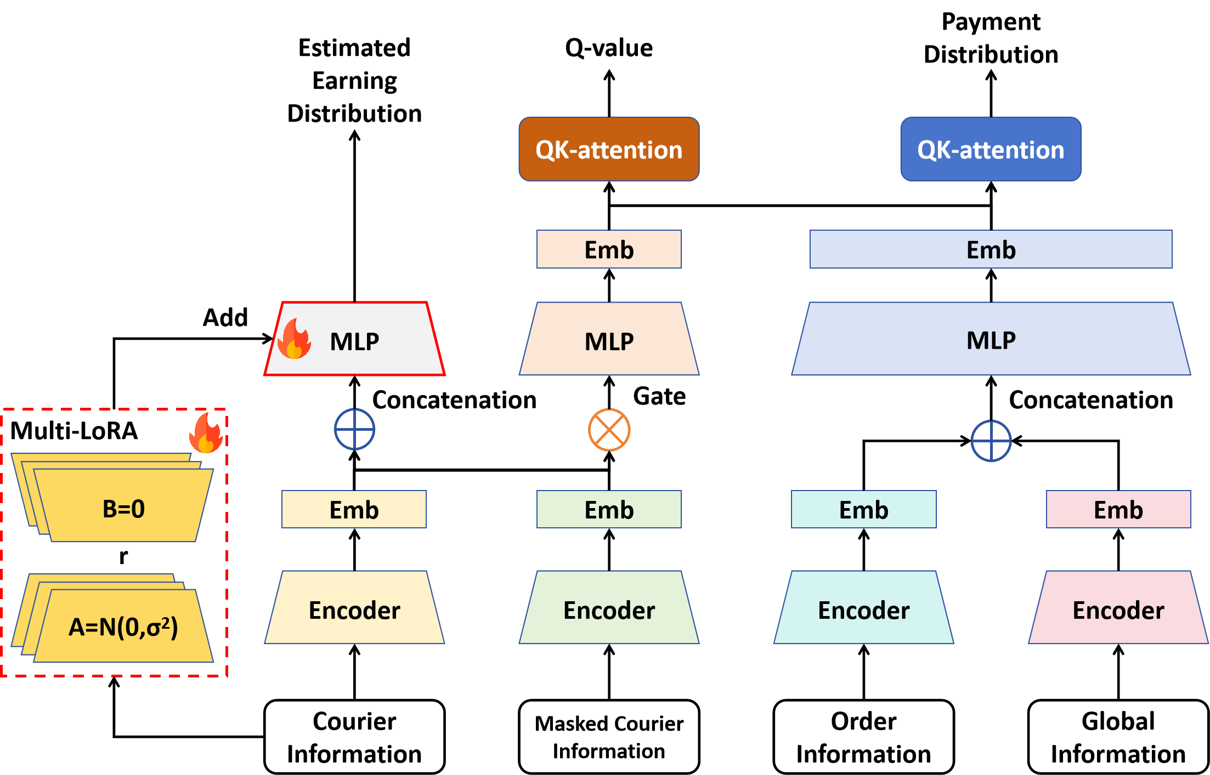
Neural Network Architecture
Shared Heterogeneous Encoder
shared structure enhances the extraction of robust features
heterogeneous structure facilitates simultaneous processing of opt-in and opt-out couriers.
Triple Decision Heads
for payment setting, order assignment, and courier long-term choice, respectively
Multi-LoRA for Couriers CMAB
shared encoder enables couriers to understand the platform's strategy
multiple lora prevents homogenous strategies among couriers, promoting diverse decision-making

